Slide 1
Vibration and Mitigation Devices
Dan Gage
Sales and Development Specialist

Slide 2
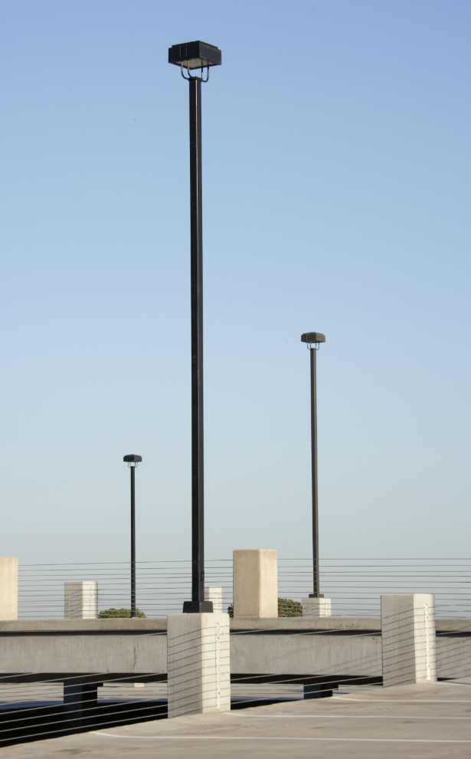
Objectives
Find signs of vibration
Understand Vortex Shedding, First Mode Vibration, and Second Mode Vibration
Learn how mitigation devices can help
See how new, lightweight LED fixtures may impact a pole

Slide 3
Signs Your Poles May Be Experiencing a Vibration
Pole Movement
Rapid, “Shaking”, back and forth in a direction perpendicular to the wind during low to moderate steady winds of 10 to 40 mph (Vortex Shedding)
Large cyclical pole top displacements which can be coupled with a whipping type action
Pole caps coming loose or falling off the pole
Audible clues
Excessive wire slap
Engagement of dampener
Rattling of components

Slide 4
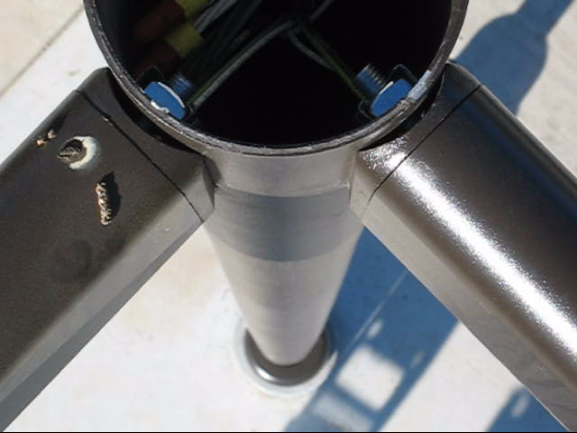
Vortex Shedding

Slide 5
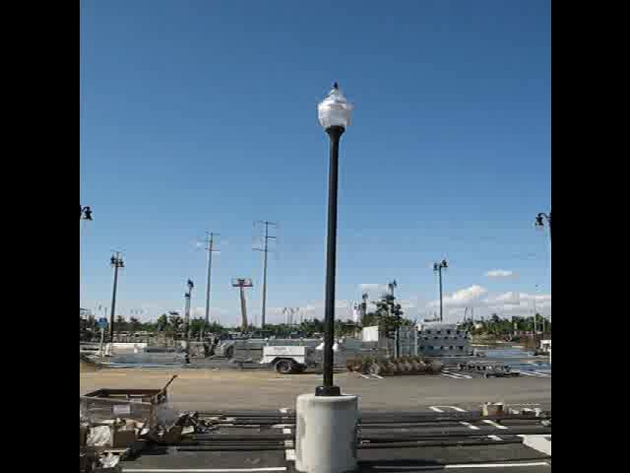
Whipping

Slide 6
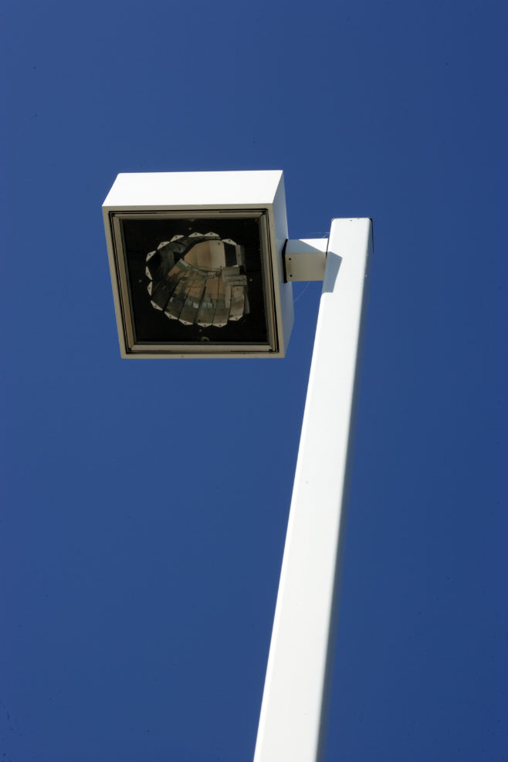
Signs Your Poles May Be Experiencing a Vibration
Fixtures
Premature lamp failure (older style fixture)
Broken glass, access doors keep opening, other damage
Loose attachment to pole or physical damage at mounting location

Slide 7
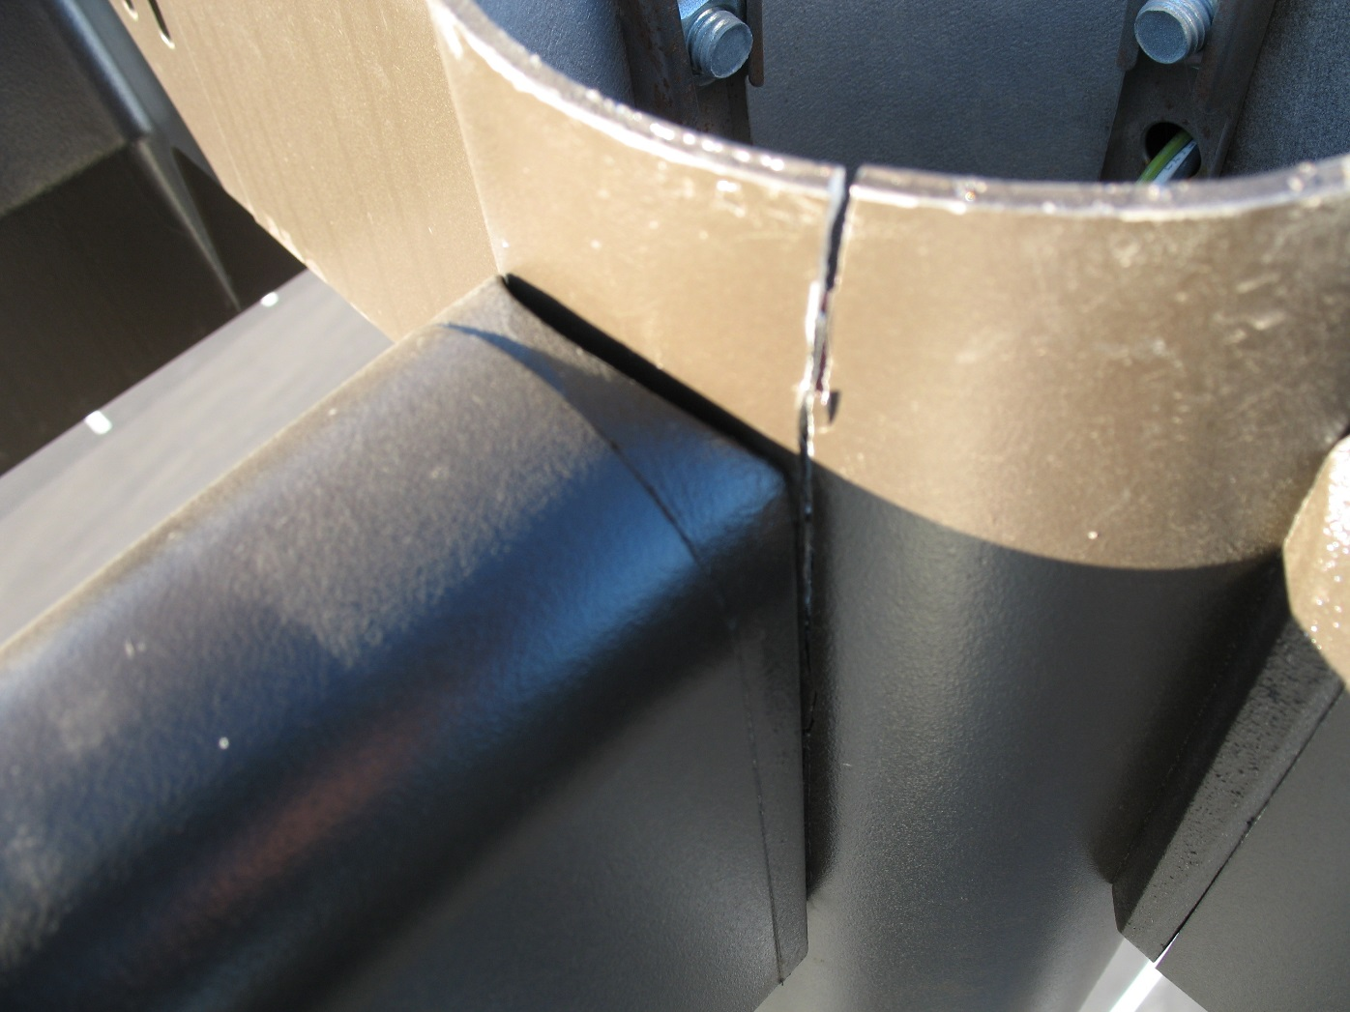
Pole Top Vibration Damage

Slide 8
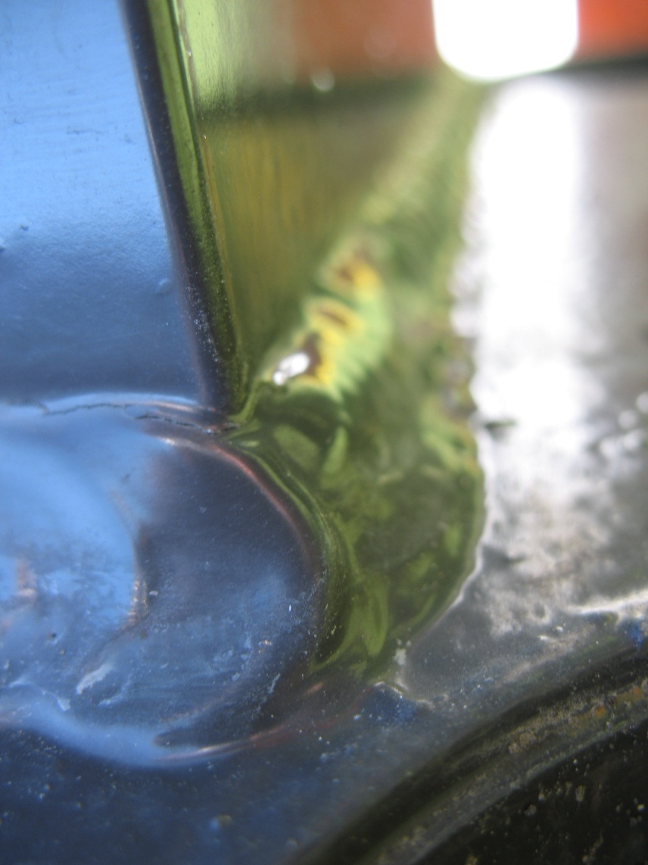
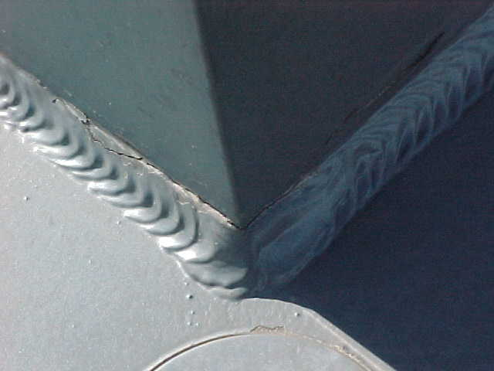
Fatigue Cracks At Toe Of Weld In Heat Affected Zone

Slide 9
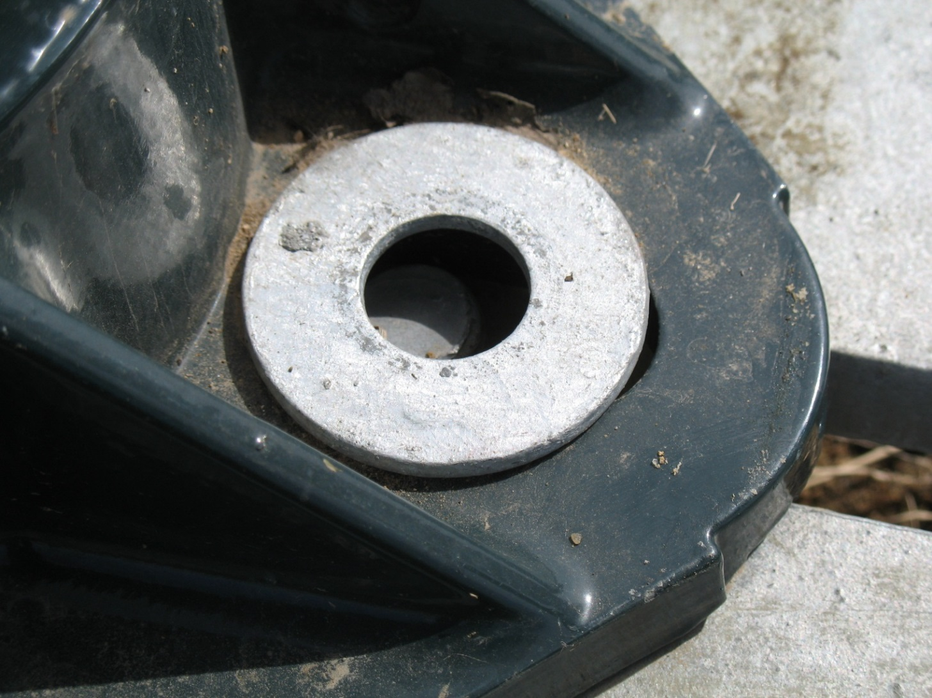
Check Security of Anchor Bolt Hardware

Slide 10
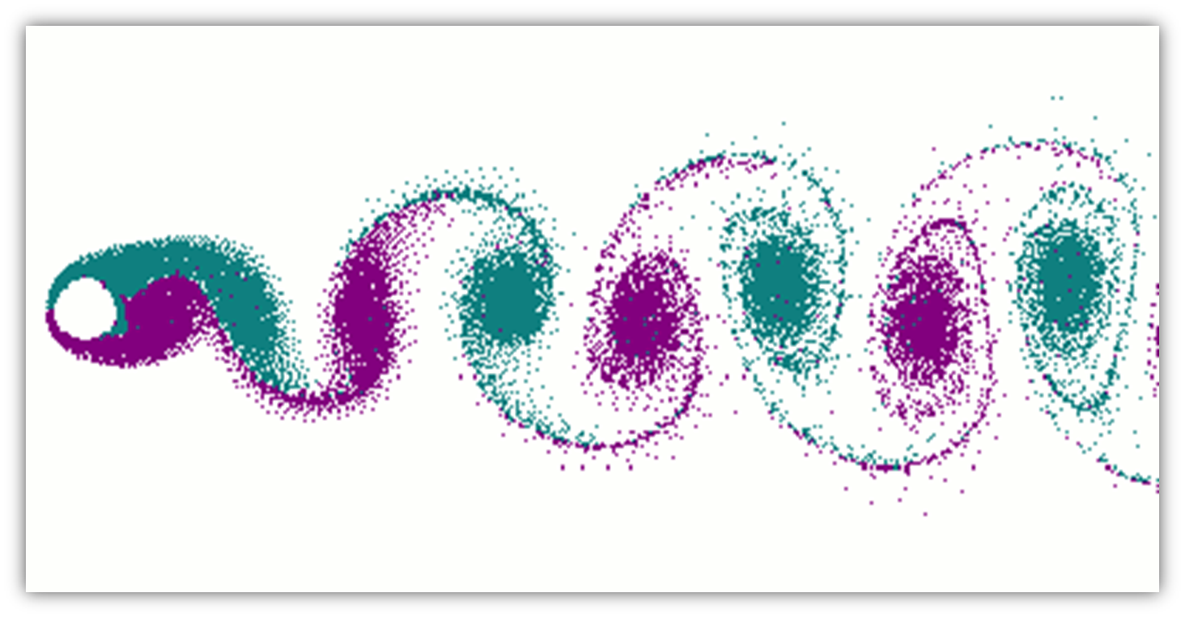
Periodic Vortex Shedding
Vortex shedding happens when wind hits a structure, causing alternating vorticies to form at a certain frequency.
The vorticies create low pressure zones on the downwind side of the structure on alternate sides.
The air flows to fill the low pressure zone and produces a vibration.
This vibration is a concern when it coincides with the natural frequency of the structure.
For structures that are tall and uniform in size and shape, the vibrations can lead to fatigue failure.
Wind direction

Slide 11
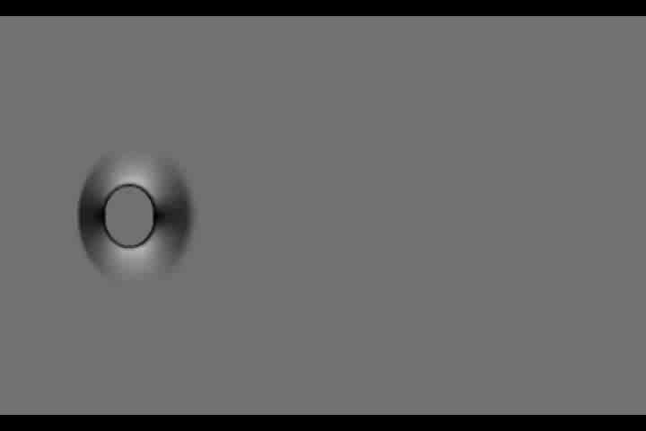
Vortex Video

Slide 12
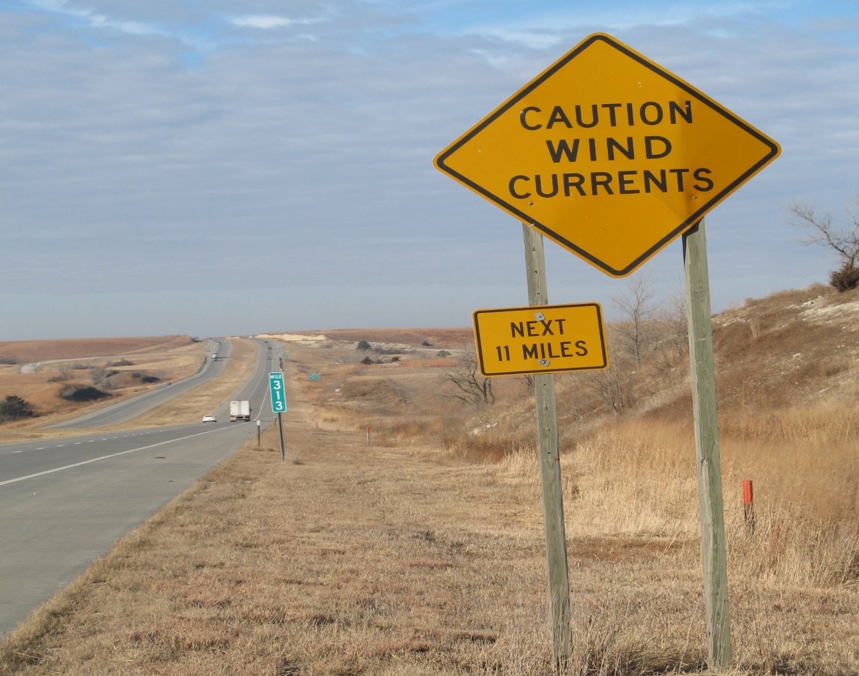
Site Conditions, a Contributing Factor
Pole vibration can occur anywhere, but some sites are more prone than others.
Vibration is common in areas of low, constant wind with limited areas of protection.

Slide 13
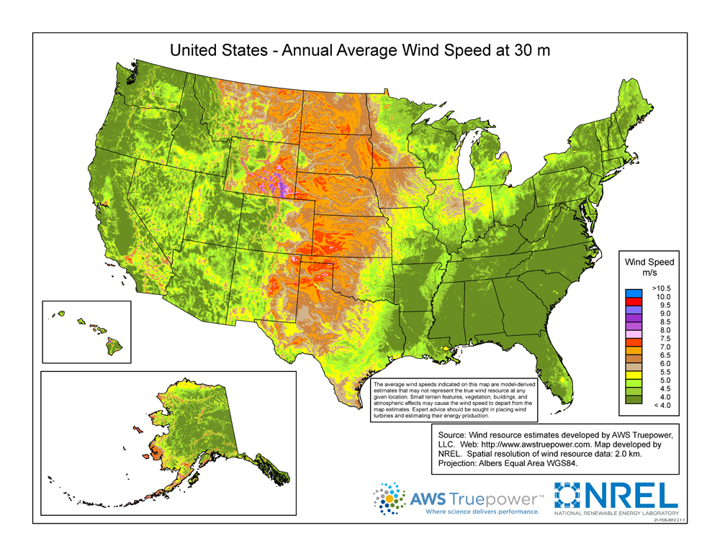
Site Conditions, a Contributing Factor
The middle third of the country is the most prone to constant wind, increasing the likelihood of vibration.

Slide 14
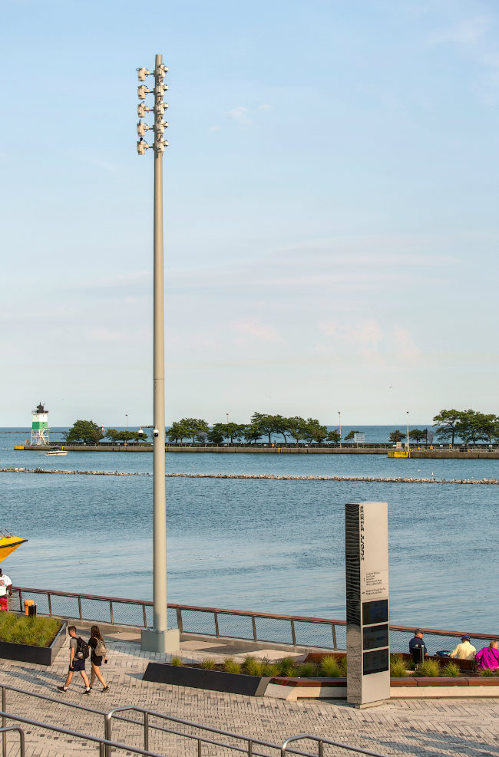
Other Site Contributing Conditions
Areas near large bodies of water
Hills or berms
Wind tunnel affects between buildings
Areas of high wind energy (DOE maps)

Slide 15
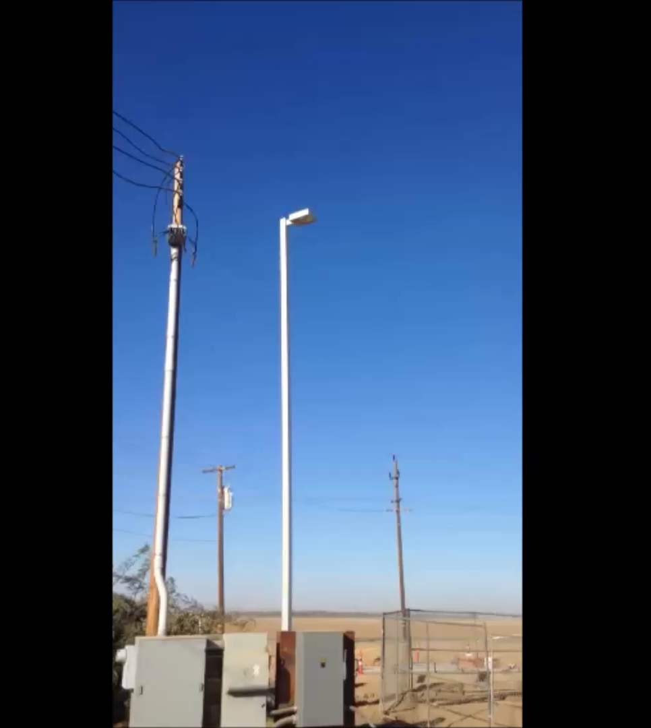
Site Conditions, a Contributing Factor
Large open areas without obstruction to the wind

Slide 16
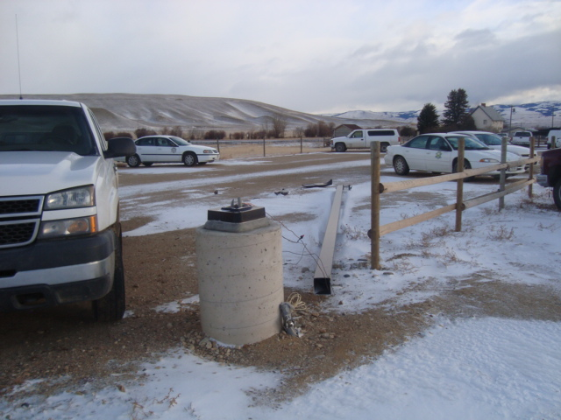
Site Conditions, a Contributing Factor
Mountain Areas

Slide 17


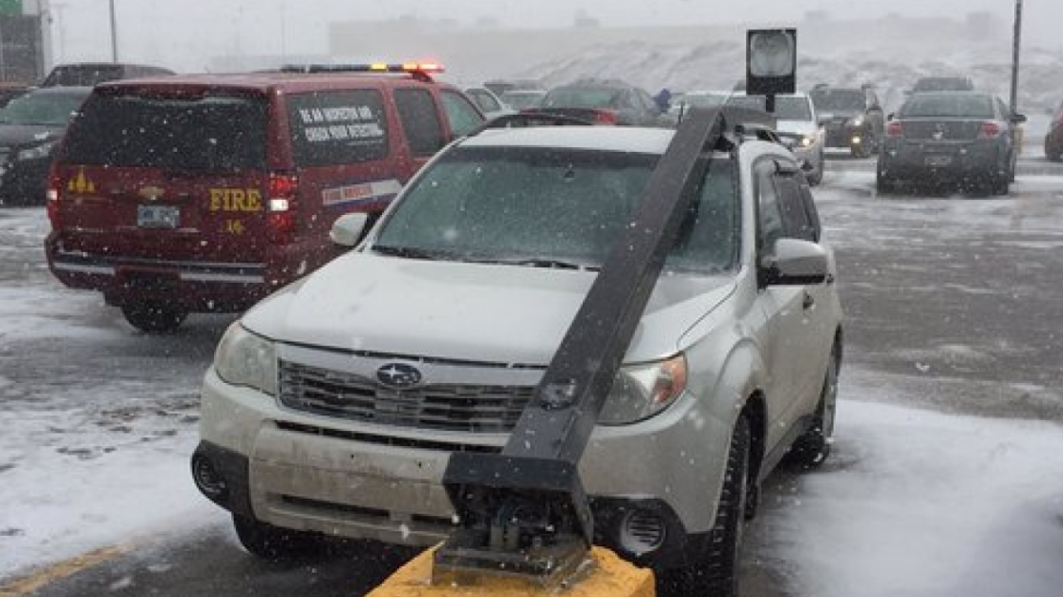
Vibration Modes
There are two modes of vibration that affect poles. These differ in how the pole moves, but both can cause severe damage to the pole itself.
First
Mode
Second
Mode

Slide 18
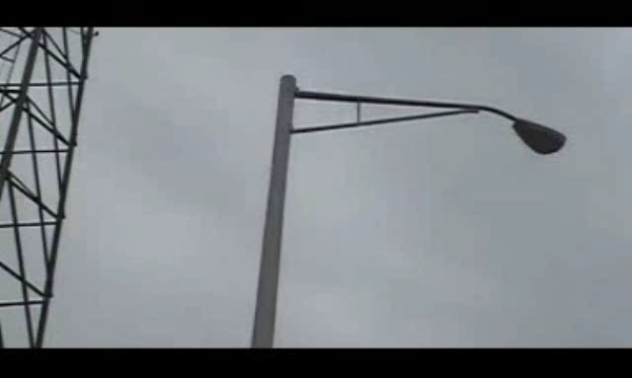
Vibration Modes
Second Mode Vibration
(2 to 7 Hz)
Most common type of vibration in the past.
Problem was resolved in the 1970’s.
Pole companies have internal guidelines for damping.

Slide 19
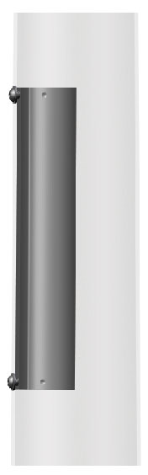
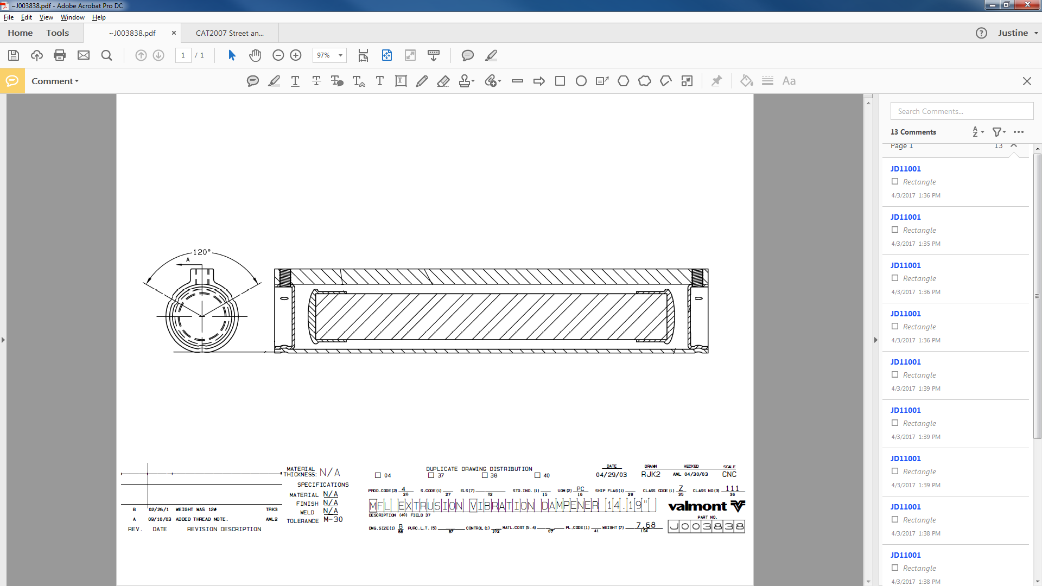
Second Mode Damper: Canister
The internal canister is installed in the top third of the pole.
The canister has a weight inside that rests on the base of the canister and will move when the pole moves.
This movement disrupts the movement and frequency of the pole and is effective for 2nd mode vibration due to vortex shedding.
Canister
Weight with rubber caps
Cross section
2D drawing
3D rendering

Slide 20
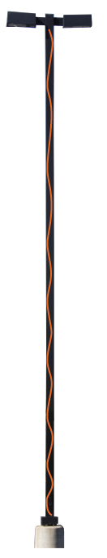
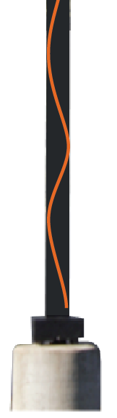
Second Mode Damper: Snake
The snake damper can be installed in the field by a contractor. The 3/8” wire cable with black poly tubing is placed through the handhole and climbs the height of the pole.
This form of damping device can be used on poles up to 50’ in height.
The wire is meant to disrupt any movement, reducing the chance of the pole reaching its natural frequency.
Does not effect electrical wires.

Slide 21
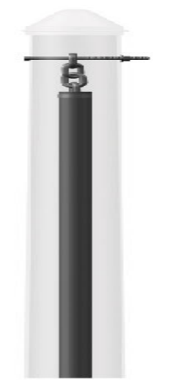
Second Mode Damper: Chain
The chain damper can also be installed in the field by a contractor on poles that are less than 50’ in height.
The chain and weight are mounted to the top of the pole. The weight is held down by gravity, and will hit the walls of the pole when the pole begins to move.
Noise will occur when the damper is active, however, the pole vibration will be limited. This damper is effective for 2nd mode vibration from vortex shedding.
Up to 14”

Slide 22
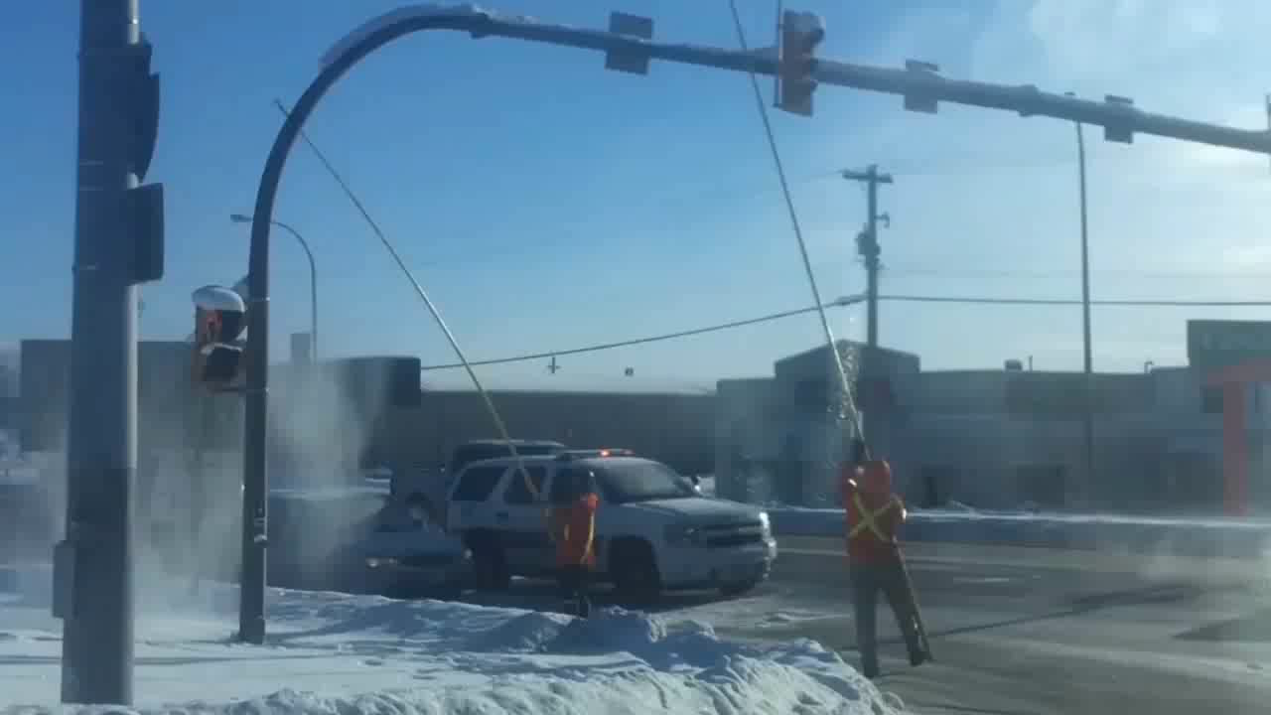
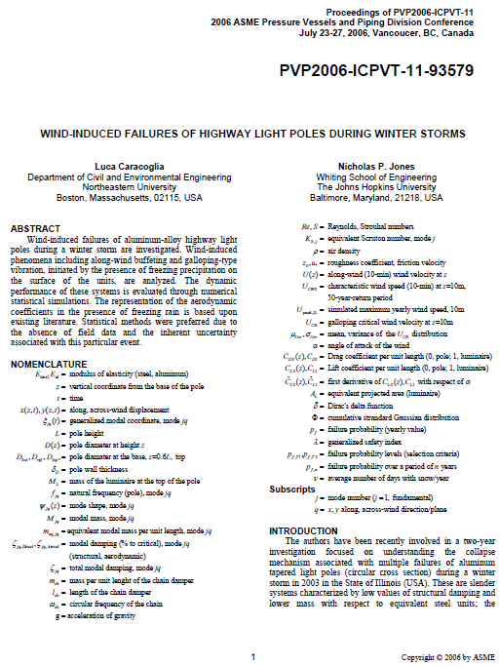
Winter Pole Failure
Past Round Tapered Aluminum pole failures have been suspected of having frozen precipitation build up causing the wind to act on an asymmetric shape.
This produces vortex shedding and 2nd mode vibration.
See Paper “Wind Induced Failures of Highway Light Poles During a Winter Ice Storm”
Johns Hopkins University study led by Dr. Nicholas Jones analyzing wind-induced phenomena initiated by the presence of freezing precipitation

Slide 23
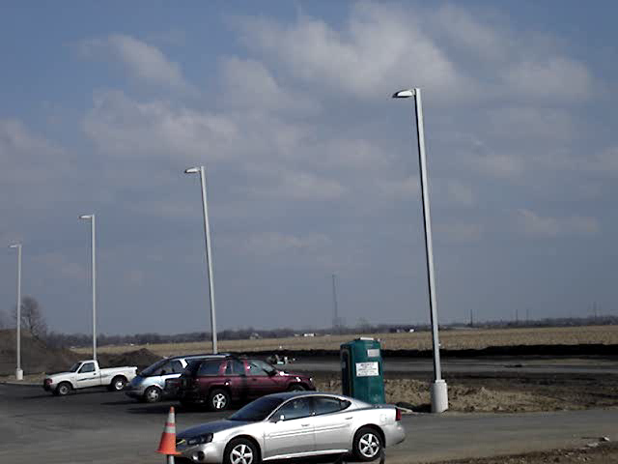
First Mode Pole Vibration
First Mode Vibration
(1 Hz)
Least common type of vibration in the past.
Problem has more recently been documented.
New fixture designs may be contributing to more reports.
Pole companies have recently developed solutions.

Slide 24
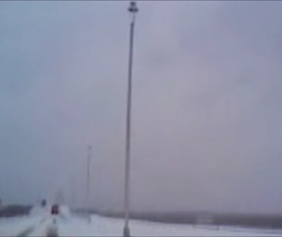
First Mode Vibration Video
Winter storm
Notes:
Video

Slide 25
First Mode Damper: Canister
The internal canister is installed in the top third of the pole.
The canister has a weight inside that rests on the base of the canister and will move when the pole moves.
This movement disrupts the movement and frequency of the pole.
This is the first defense against 1st mode vibration.
Canister
Weight with rubber caps
Cross section
2D drawing
3D rendering

Slide 26
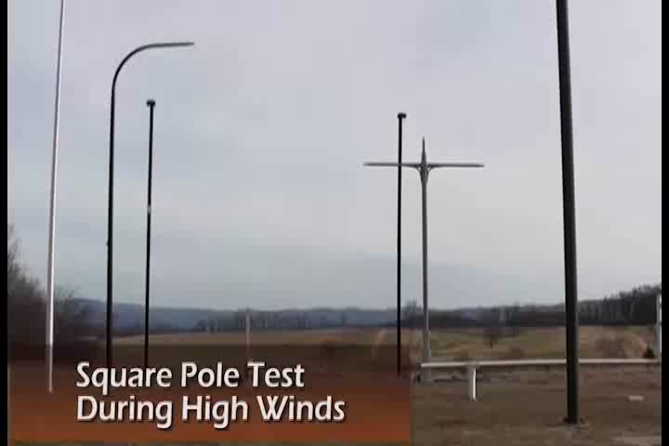
Damped Versus Undamped Stress on a 40’ Pole

Slide 27
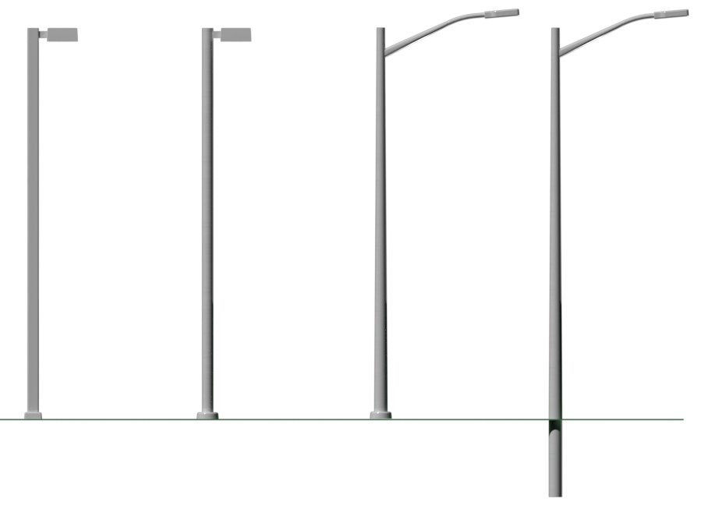
Tendency for the Structure to Vibrate
Straight Square Straight Round Round Tapered Round Tapered Embed
HIGHEST > > > > LOWEST

Slide 28
Wind Induced Vibration Facts and Fiction
Facts
“Wind induced vibration is the result of an unique combination of local site conditions, micro wind patterns, fixture geometry, and pole geometry”
Induced by low to moderate steady state winds
11 mph (low energy) < Vibration < 45 mph (turbulence)
Can impact only a single pole or small subset of poles at a site
Fixture orientation can influence potential for WIV
Smaller pole top loads can increase potential for WIV. Poles should not be standing without fixture(s).
Wind induced vibration generates fatigue cracks which grow and propagate with additional loading cycles

Slide 29
Wind Induced Vibration Facts and Fiction
Fiction
Wind induced vibration is the result of defect or inadequate design
Highly predictable
A vibration dampener completely eliminates vibration
If my pole is designed for a peak wind per design code (70 mph +) it should withstand a wind induced vibration problem (Static vs. dynamic loads)

Slide 30
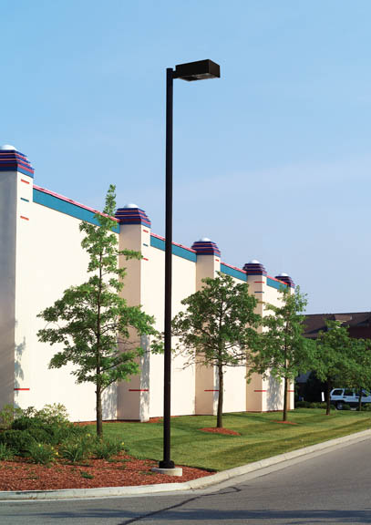
What has changed?

Slide 31
New Fixture Profiles (LED): A New Set of Variables
New Variables
Consequences
Lower EPA’s
Lower fixture weight
Common pole selection considers only static load conditions: Lower fixture EPA’s and lower fixture weights = smaller poles and smaller wall thicknesses
Lighter pole top loads increase the potential for vibration related issues, if not properly considered. This can be aggravated by taller more slender poles
Field retrofits: Even though a fixture may be lighter and have less EPA than existing, swapping fixtures changes the dynamic characteristics of the structure and should be considered.

Slide 32
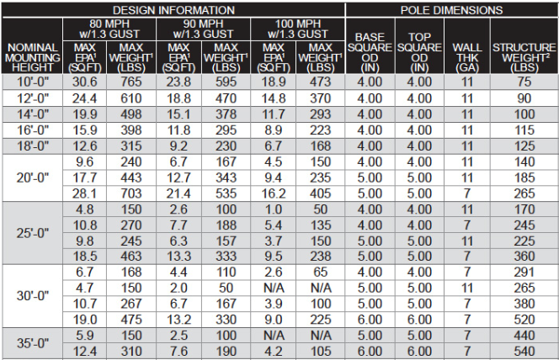
Pole Selection Process – Area Lighting
25 Ft Mtg Height - 90 MPH – 5 IN Square – 11 Ga Steel: 6.3 EPA

Slide 33
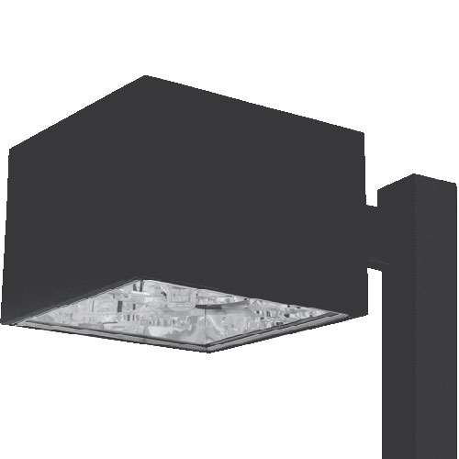
HID Fixture EPA
The EPA of a fixture is equal to the area visible by the wind at a particular angle
21 IN Square X 15 IN Deep
EPA = 2.8 sq ft Wt = 68 lbs

Slide 34
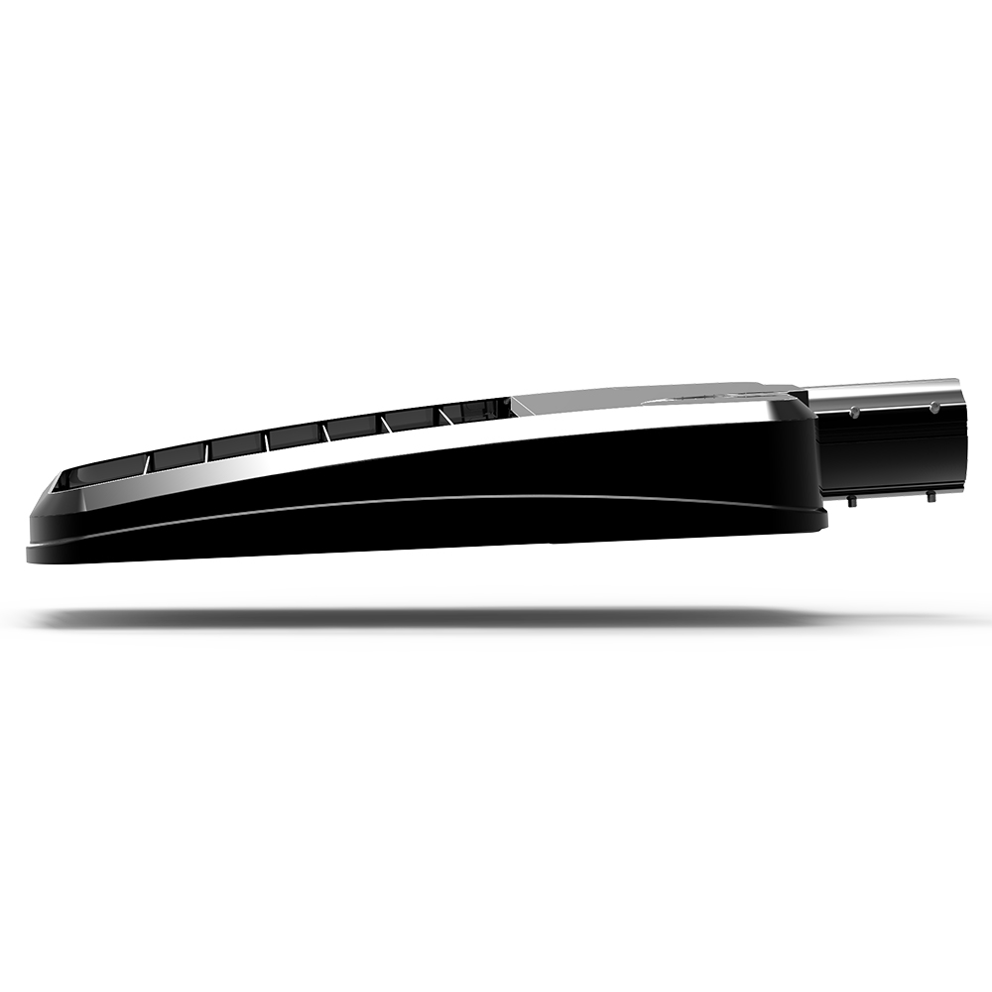
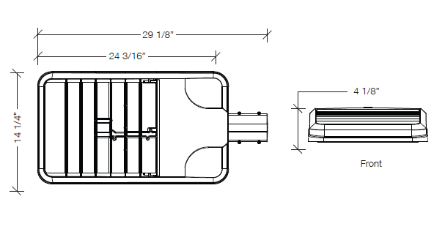

Replace HID with LED on Same Pole
EPA = 1.0 sq ft Wt = 25 lbs

Slide 35
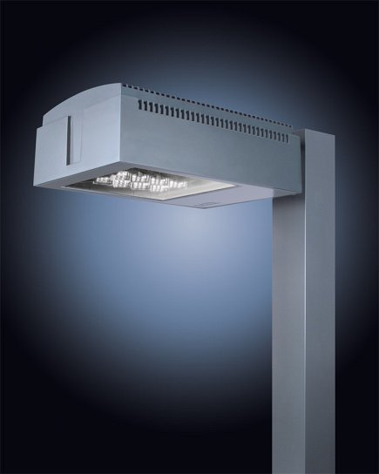
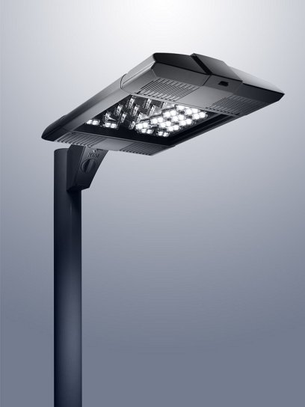
LED in Traditional Housing or new Sleeker Design
The poles are designed to have weight on the top of the pole to reduce vibration. If a fixture retrofit significantly reduces the loaded weight, steel plates can be installed to compensate for the lost weight.
EPA = 1.8 sq ft Wt = 45 lbs
EPA = .72 sq ft Wt = 34 lbs

Slide 36
Tips to Remember
Be aware of wind load requirements for job location as well as wind behavior (constant vs gusts)
Inspect all poles for cracks and rust before deciding to retrofit with new fixtures
Clear snow and salt away from pole bases in winter
If EPA load for new LED fixture is < 1.0 and fixture mounting height is > 20 ft, add a vibration dampener
Inspect poles regularly for signs of stress
When in doubt, install new poles and or vibration dampeners.

Slide 37
THANK YOU!
www.valmontstructures.com

